Slide 1


Chaos Monkey Experiments: Strengthening Banking Systems
Welcome to SIDGS Global Solutions' demonstration on Chaos Engineering for robust banking systems. We'll explore how controlled failures can uncover vulnerabilities and enhance system resilience.

Slide 2
AGENDA
Understanding Chaos Engineering
Why Banks Need Chaos Engineering
Chaos Experiment Phases
Common Use Cases Of Chaos Engineering
Chaos Mesh
Bank of Anthos: GKE Application Demo
Bank Of Anthos: Cloud Native Application Architecture
Experiment:1 – Microservice Resilience
Experiment:2 – System Resilience Test
Experiment:3 - Network Partition: Critical Vulnerabilities Exposed
Appendix
Chaos Engineering: A Strategic Approach
Chaos Work-Flow
Chaos Mesh Architecture Key Components
How Chaos Mesh Works: A Three Step Process

Slide 3

Understanding Chaos Engineering
Proactive Resilience Testing
Controlled Experimentation
Chaos Engineering simulates real-world disruptions to identify system weaknesses before they become critical.
All chaos experiments are carefully planned, monitored, and safely rolled back if needed.

Slide 4



Why Banks Need Chaos Engineering
Customer Trust
1
Prevents downtime that erodes confidence in digital banking platforms.
Real-Time Insights
2
Protects critical systems like Kafka pipelines handling millions of transactions.
High Availability
3
Ensures 24/7 availability for essential services like payment processing.

Slide 5
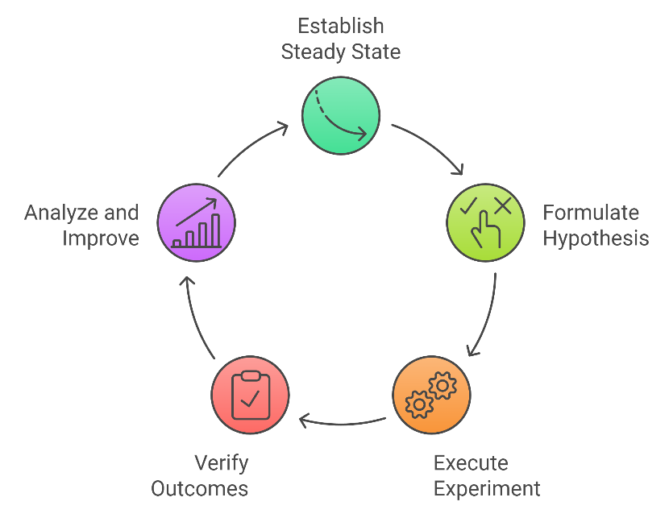
The Chaos Engineering Phases
1
Steady State
Establish normal system behavior as a baseline for comparison.
2
Hypothesis
Define expected deviations and tolerance ranges for system behavior.
3
Run Experiment
Execute controlled, destructive actions to test system resilience.
4
Verify & Analyze
Validate results, analyze unexpected outcomes, and implement improvements.

Slide 6

Common Use Cases of Chaos Engineering
Infrastructure Disruptions
Performance Stressors
Simulate microcomponent failures, VM shutdowns, and data center disconnections to test system resilience.
Inject latency, simulate high CPU/memory loads, and cause traffic spikes to evaluate system stability.
Software-Level Chaos
Complex Scenarios
Introduce function exceptions, code insertions, and clock syncing issues to uncover hidden vulnerabilities.
Emulate I/O errors and inject intricate failures to prepare for real-world contingencies.

Slide 7
Chaos Mesh: A Powerful Chaos Engineering Tool
Chaos Mesh is an open-source chaos engineering platform designed specifically for Kubernetes environments. It enables DevOps teams to simulate and test system responses to various failure scenarios, from network latency to pod crashes.
The platform is built on a flexible architecture using Kubernetes Custom Resource Definitions (CRDs), which serve as blueprints for different types of chaos experiments. This design allows teams to:
Deploy sophisticated fault injections through specialized CRDs like PodChaos, NetworkChaos, and IOChaos
Chaos Controller Manager: The Controller Manager watches for changes in Chaos Mesh CRDs. Upon detecting a new or updated CRD, it schedules the experiment to specific Chaos Daemon to execute the experiment.
At the heart of this architecture lies the Chaos Daemon, which executes these experiments directly within the Kubernetes cluster.
Chaos Dashboard: It is an interactive dashboard used to visualize the experiments and monitor the events.

Slide 8
Let’s Take A Look At Chaos Mesh Dashboard

Slide 9
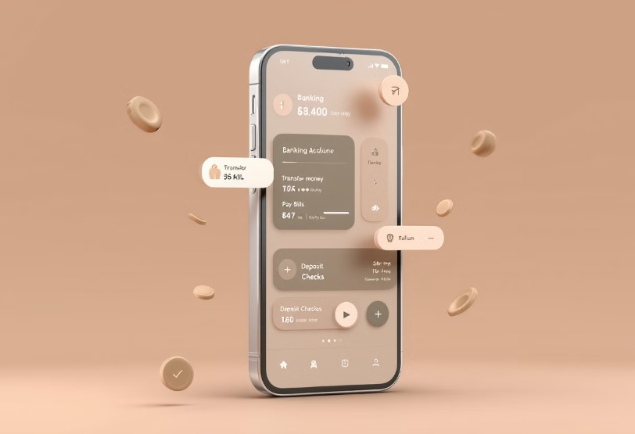
Bank of Anthos: GKE Application Demo
Experience a fully-functional cloud-native banking application built with modern microservices architecture. This demo showcases real-world financial transactions, account management, and secure user authentication—all powered by Google Kubernetes Engine (GKE).
Perfect for developers and architects looking to understand how to build and deploy scalable, production-ready applications on GKE using best practices in containerization and microservices design.

Slide 10
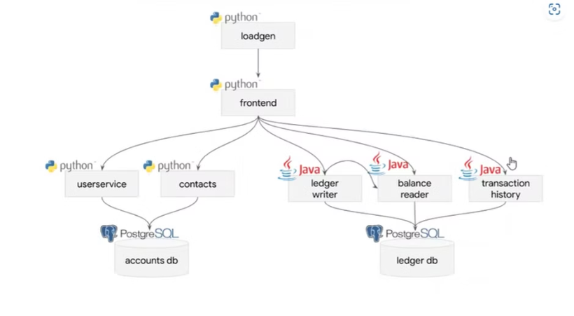
Bank of Anthos:
Cloud-Native Application Architecture
Bank of Anthos represents a cutting-edge cloud-native banking platform built on Google Cloud Platform, processing over 10,000 transactions per second with 99.99% reliability.
This sophisticated application combines a responsive web interface, microservices-based backend, and enterprise-grade security to demonstrate modern retail banking capabilities.
Through its innovative architecture, it showcases how financial institutions can leverage cloud technologies to deliver scalable, secure, and highly available banking services.

Slide 11
Let’s Take A Look At Bank Of Anthos Application UI

Slide 12
Let's get into the Experiments

Slide 13
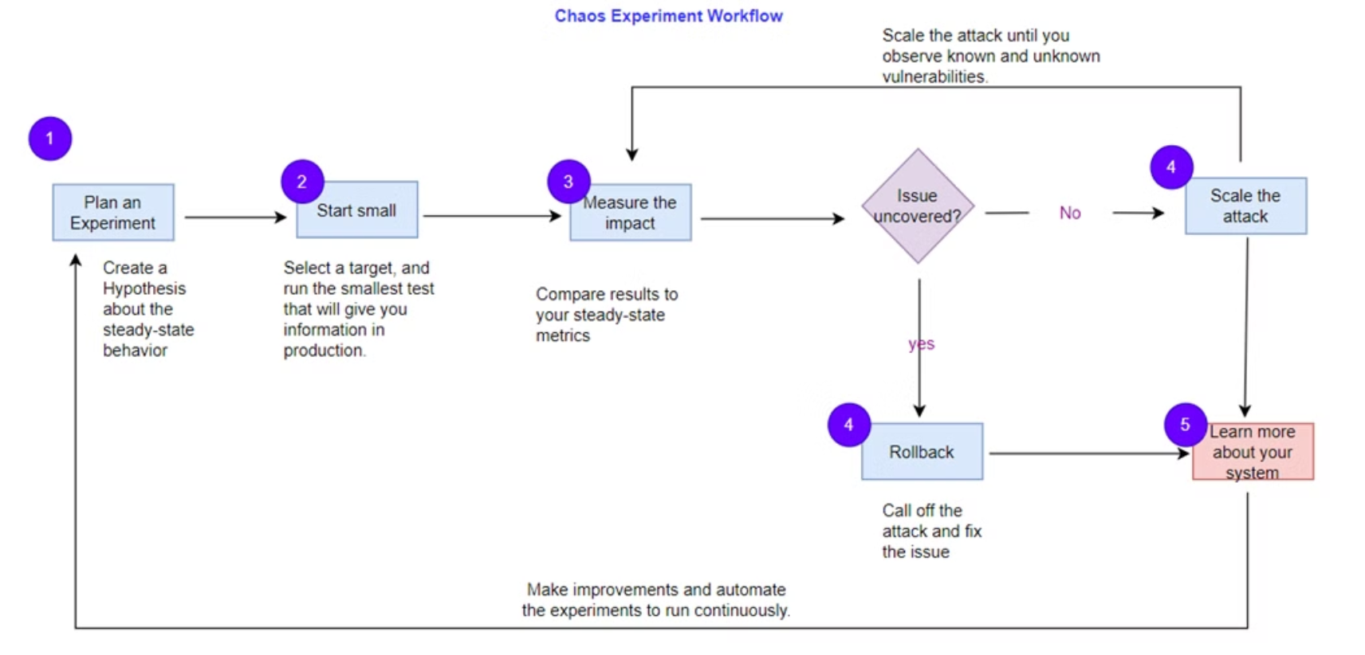
Chaos Workflow

Slide 14
Experiment:1 - Microservice Resilience
1
Experiment Setup
We conducted a resilience test by terminating a Microservice pod and keeping it down for 100 seconds. The purpose was to evaluate the application's ability to handle sudden service disruptions.
2
Observed Results
During the pod's downtime, the application ceased to function. Users experienced service interruptions, likely encountering failure message. This indicates a critical vulnerability in our system's fault tolerance.
3
Conclusion & Recommendations
The experiment revealed that our application is not resilient. To address this, we recommend implementing a Circuit Breaker pattern or deploying a backup system for immediate failover. These measures will help maintain service continuity during pod failures or restarts.
This experiment underscores the importance of robust fault-tolerance mechanisms in Microservice architectures.
By implementing these improvements, we can significantly enhance our application's resilience and minimize user-facing disruptions during inevitable infrastructure hiccups.

Slide 15
Experiment 2: System Resilience Test
Test Scenario
Results & Remediation
10-seconds latency induced
System failed
Purpose: Evaluate system behavior under unexpected latency
Preferred Action: Circuit breaker or immediate backup switch

Slide 16
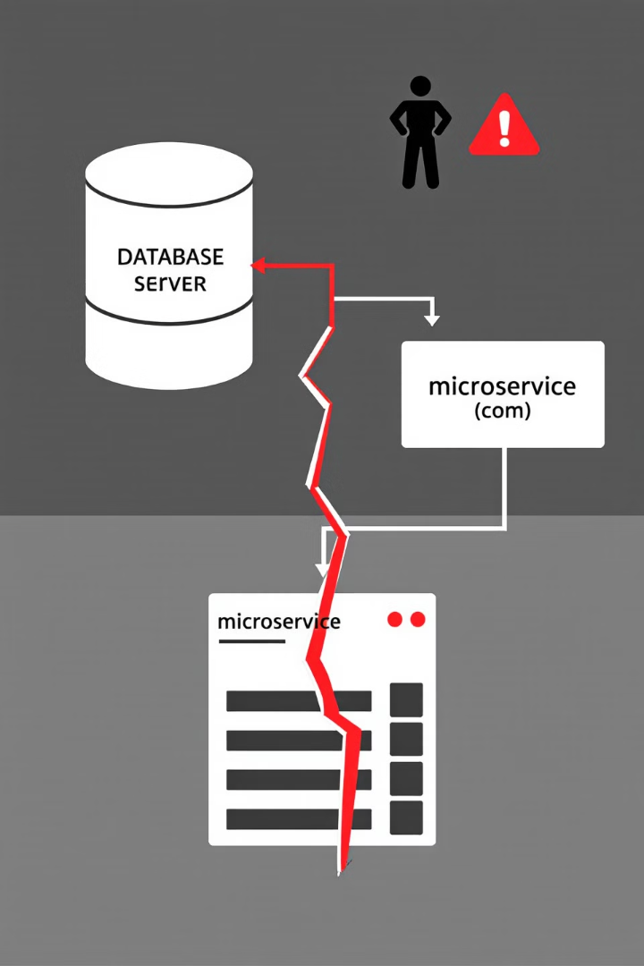
Network Partition Test: Critical Vulnerabilities Exposed
1
Test Setup
100-second network partition induced between ledger-db and ledgerwriter microservice using Chaos Mesh.
2
Observed Impact
100% payment transaction failure.
3
Root Cause
No automatic failover mechanism present.
4
Remediation Plan
Implement Redis cache, Resilience4j Circuit Breaker, and automatic failover to standby DB.

Slide 17
Appendix

Slide 18
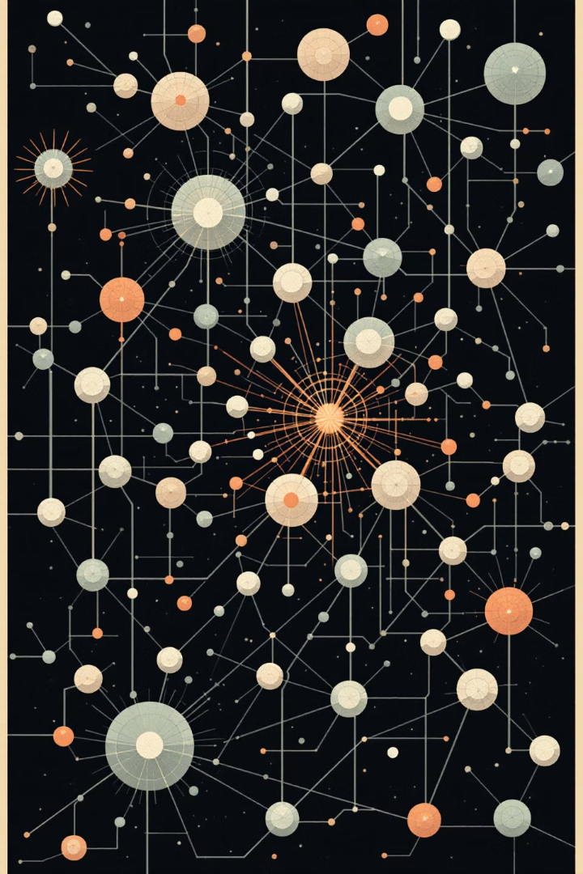



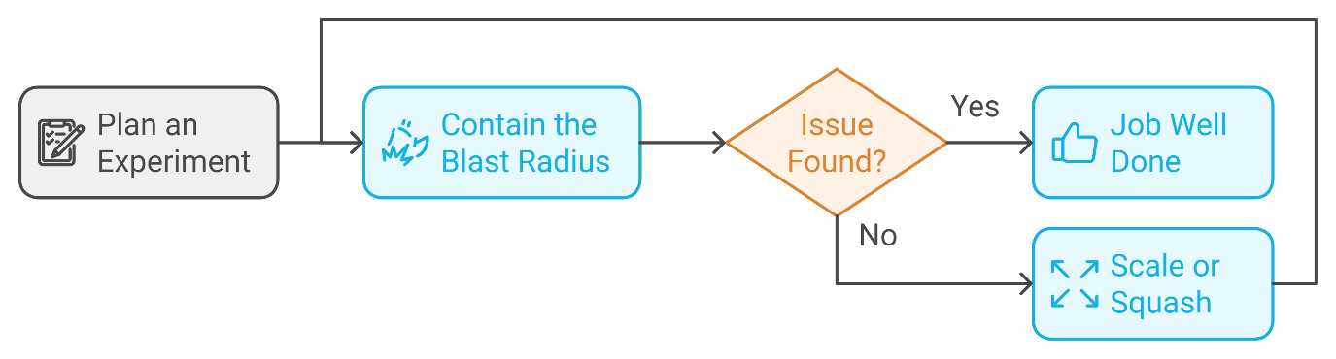
Chaos Engineering: A Strategic Approach
Plan the Experiment
Create hypothesis, identify potential failure points
Contain Blast Radius
Execute smallest test, gain valuable insights
Scale or Squash
Resolve issues or increase scope gradually

Slide 19
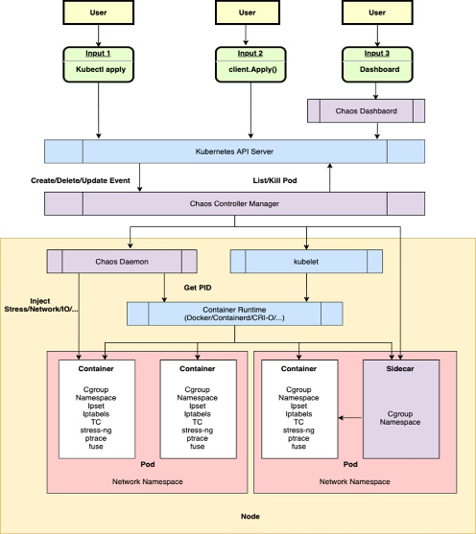
Architecture - Key Components
Chaos Daemon is the core execution engine that runs as a privileged DaemonSet pod on each Kubernetes node in the cluster. It directly interfaces with low-level components including container runtimes (Docker, containerd), the Linux kernel, and iptables to inject various types of faults at the infrastructure level.
The daemon implements specific chaos operations through specialized modules:
- NetworkChaos: Implements TCP packet delays, drops, and corruption using iptables rules
- PodChaos: Forces pod failures, restarts, and kills using container runtime APIs
- StressChaos: Injects CPU/memory pressure using system stress testing tools
- IOChaos: Simulates disk read/write latency using IO control mechanisms
Please note :
When a chaos experiment is initiated through Chaos Mesh CRDs, the daemon receives instructions from the Controller Manager and executes these low-level operations with precise timing and parameter control, while maintaining detailed logs and metrics for experiment analysis.

Slide 20
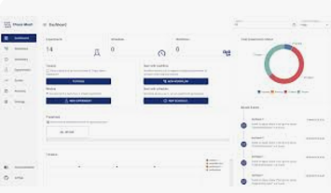
In Continuation-
Chaos Controller Manager: The central control plane component that manages the lifecycle of chaos experiments. It watches for new chaos custom resources, schedules experiments, and coordinates with Chaos Daemon to execute fault injections. The controller manager ensures proper orchestration and maintains the desired state of chaos experiments across the cluster
Chaos Dashboard: The web-based user interface that provides visualization and management of chaos experiments. It enables users to create, monitor, and analyze chaos engineering tests through an interactive graphical interface, making it easier to track experiment progress and results

Slide 21
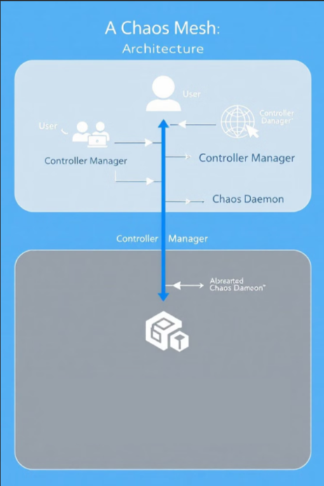



How Chaos Mesh Works: A Three-Step Process
User Interaction
Users define chaos experiments using Kubernetes custom resource definitions (CRDs).
Controller Manager
Watches for CRD changes and schedules experiments to specific Chaos Daemons.
Chaos Daemon Execution
Receives instructions from the Controller Manager and injects failures into target pods or nodes.

Slide 22
Any Queries ?

